Slide 1
MODULE-4
Growth – Story Telling Representation – Strategic Foresight - Change – Sense Making -

Slide 2
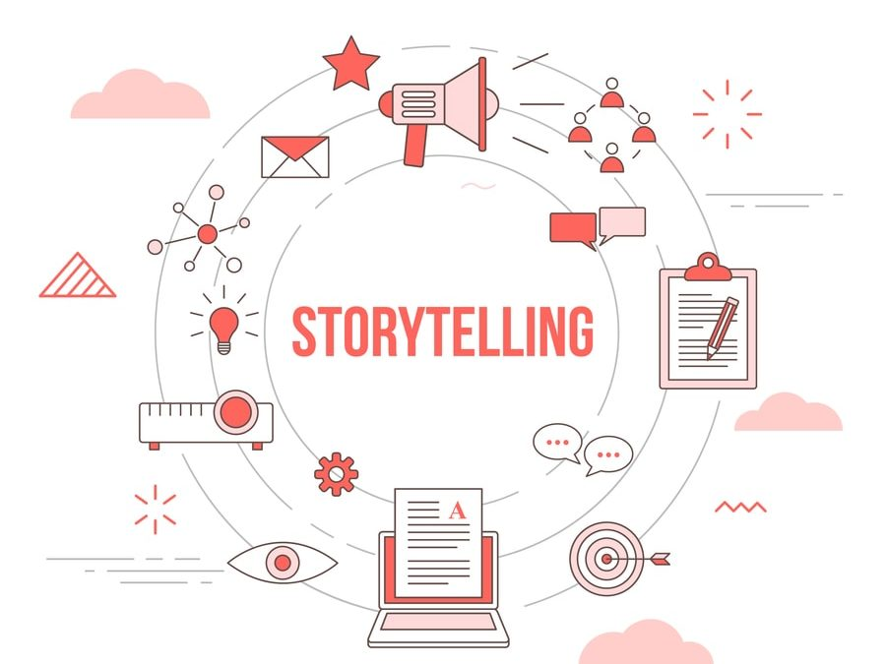
Introduction
Growth, storytelling, strategic foresight, change, and sense-making are interconnected concepts that play crucial roles in navigating complex environments.
Understanding the dynamics of these elements is essential for organizations looking to thrive in the ever-evolving landscape of business.
This presentation will delve into each of these topics and explore their significance in driving sustainable growth.
1
Notes:
Image source: https://www.growth-hackers.net/steps-build-storytelling-framework-resonates-target-audience/

Slide 3
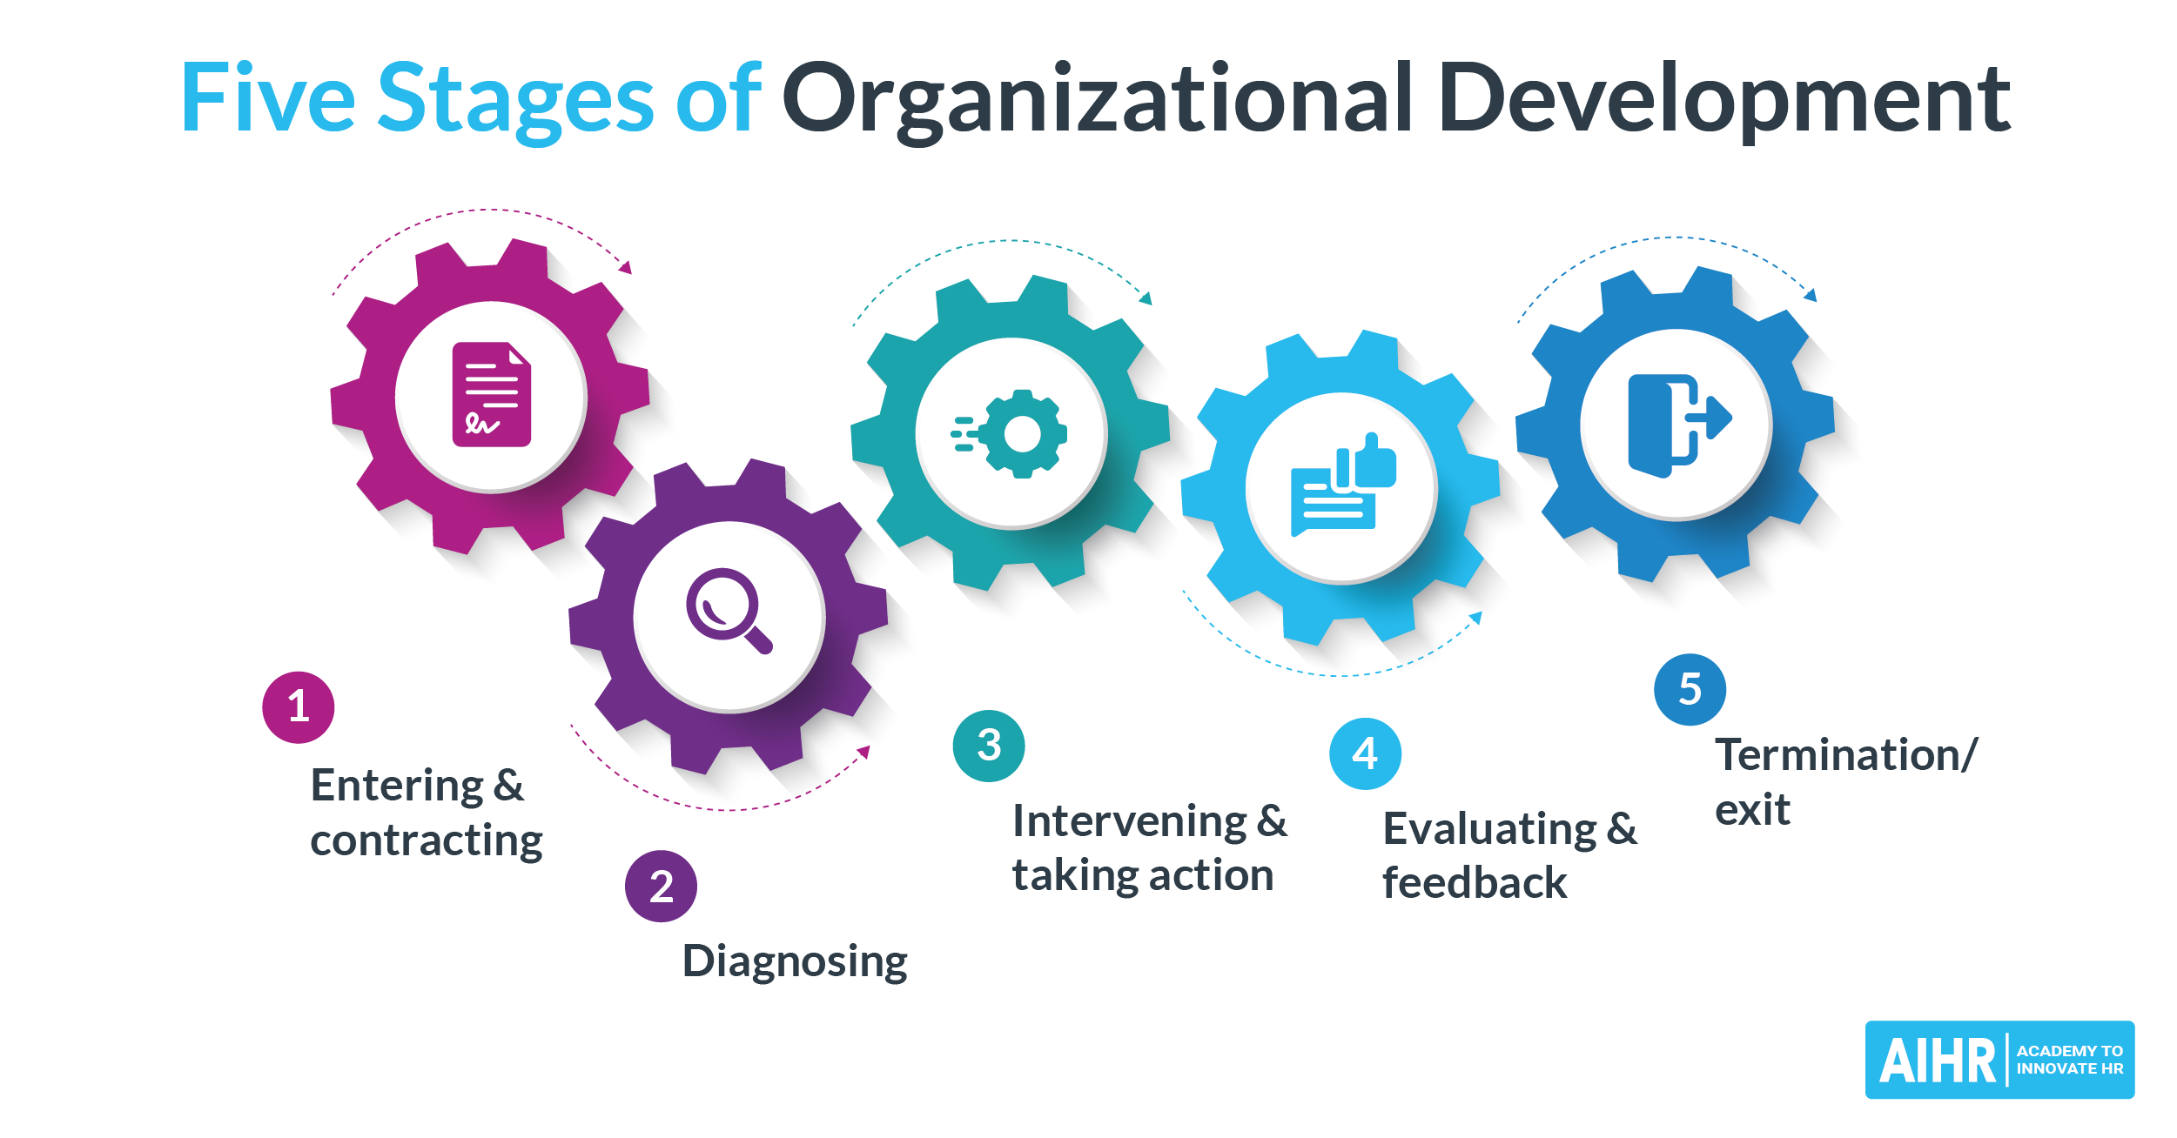
Growth
Growth is not just about expanding revenues; it also encompasses personal and organizational development.
Sustainable growth requires a clear vision, strategic planning, and continuous adaptation to changing circumstances.
Organizations that prioritize innovation and learning are more likely to achieve long-term growth.
2
Notes:
Image source: https://www.aihr.com/blog/stages-of-organizational-development/

Slide 4
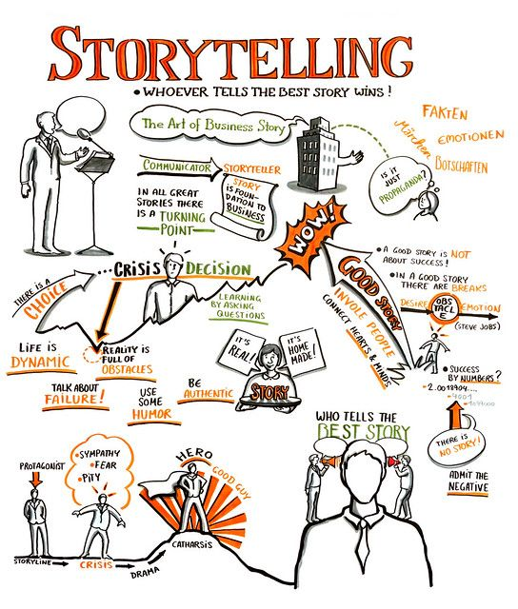
Storytelling Representation
Storytelling is a powerful tool for conveying complex ideas and engaging audiences on an emotional level.
Effective storytelling can shape perceptions, influence decisions, and inspire action.
By crafting compelling narratives, organizations can create a shared understanding of their purpose and values.
3
Notes:
Image source: https://www.pinterest.com/pin/318629742389023875/

Slide 5
Strategic Foresight
Strategic foresight involves anticipating future trends and disruptions to proactively shape strategies.
Organizations that practice strategic foresight are better equipped to identify opportunities and mitigate risks.
By scanning the external environment and scenario planning, businesses can enhance their agility and resilience.
4
Notes:
Image source: https://www.weforum.org/agenda/2023/02/strategic-intelligence-why-foresight-key-future-readiness/

Slide 6
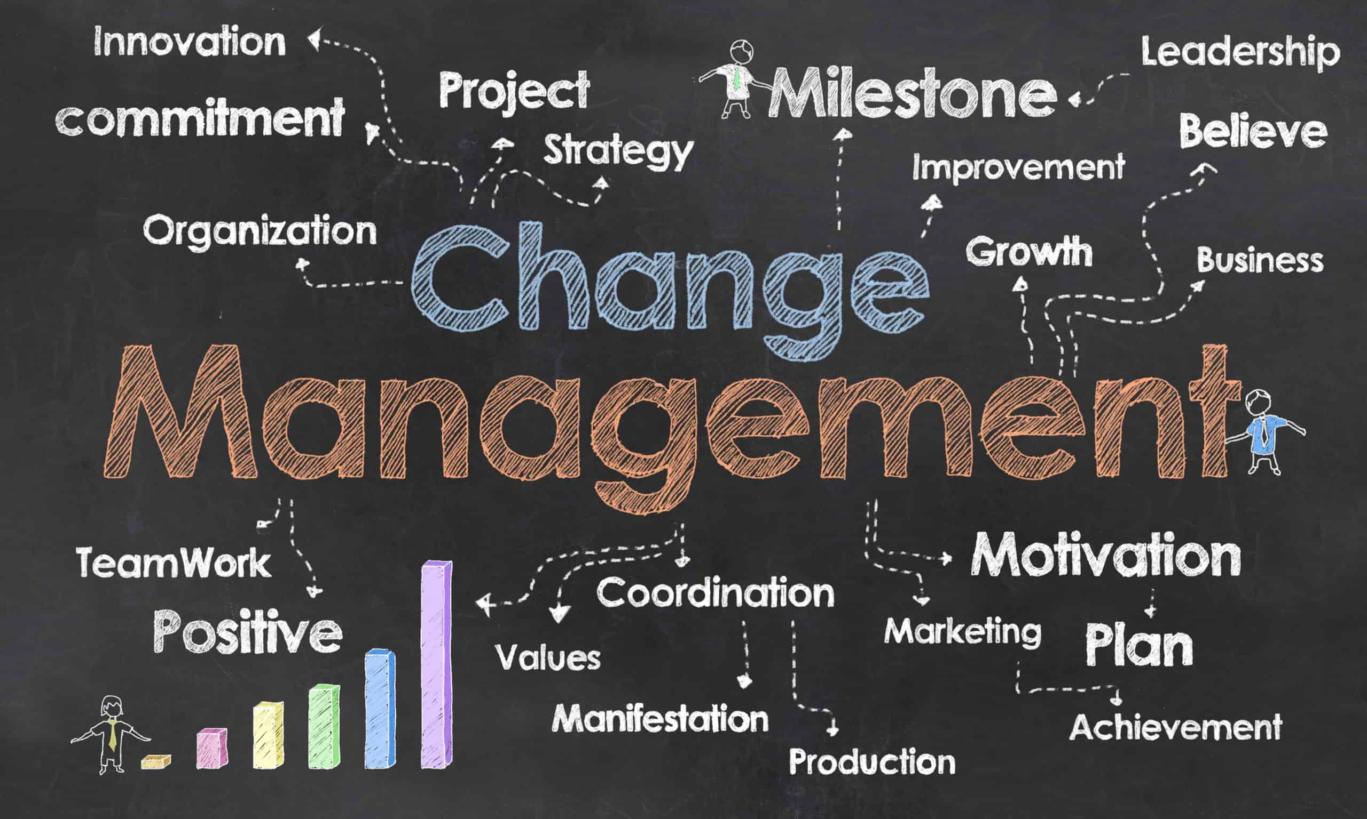
Change
Change is inevitable in today's fast-paced world and is often met with resistance.
Successful change management requires effective communication, stakeholder engagement, and a supportive organizational culture.
Embracing change as a constant enables organizations to adapt and thrive in turbulent environments.
5
Notes:
Image source: https://www.hicx.com/blog/change-management/

Slide 7
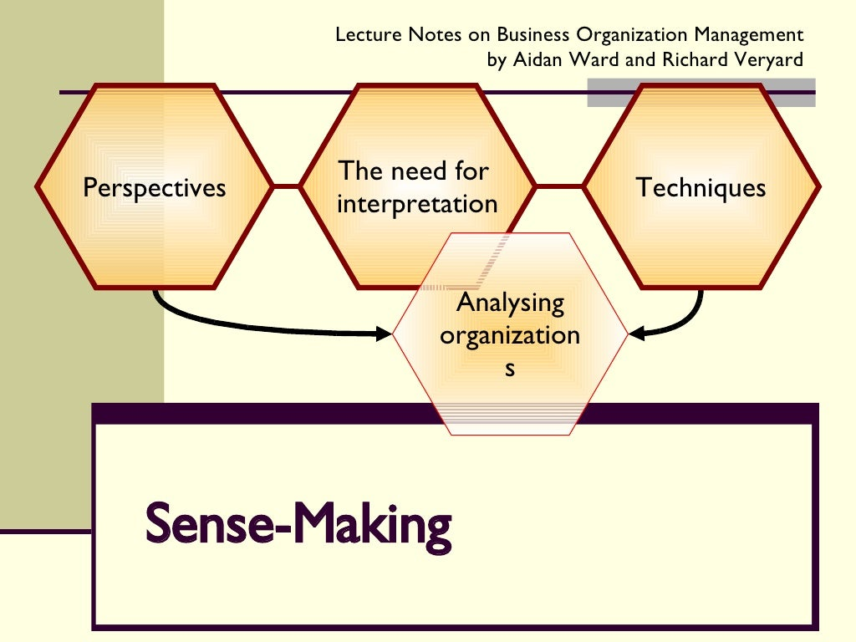
Sense Making
Sense-making is the process of interpreting information and making sense of complex situations.
Sense-making helps individuals and organizations navigate ambiguity, connect dots, and derive meaning from chaos.
By fostering a culture of sense-making, organizations can enhance decision-making and drive innovation.
6
Notes:
Image source: https://www.slideshare.net/RichardVeryard/sensemaking-presentation

Slide 8
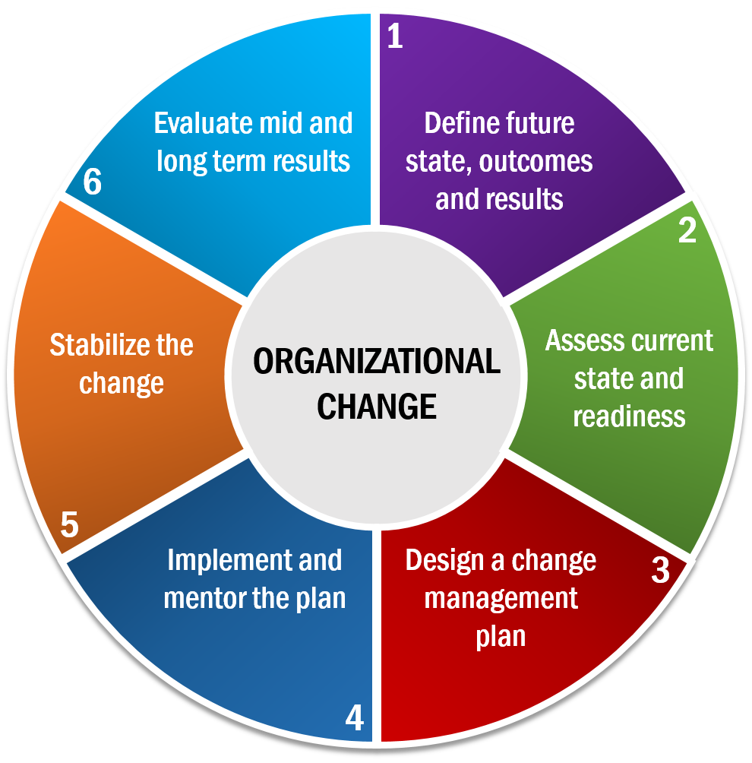
Integrating Concepts
Growth, storytelling, strategic foresight, change, and sense-making are interconnected elements that fuel organizational success.
By weaving these concepts together, organizations can create a holistic approach to navigating uncertainty and driving transformation.
Embracing the interplay of these concepts enables organizations to build resilience, foster creativity, and seize opportunities.
7
Notes:
Image source: http://oecstrategicsolutions.com/services/organizational-change/

Slide 9
Leveraging Storytelling for Growth
Storytelling can be a powerful tool for communicating a compelling vision of growth and transformation.
By crafting narratives that resonate with stakeholders, organizations can inspire commitment and alignment towards shared goals.
Leveraging storytelling as a strategic asset can differentiate organizations in competitive markets and build emotional connections with customers.
8
Notes:
Image source: http://keywordsuggest.org/gallery/597124.html

Slide 10
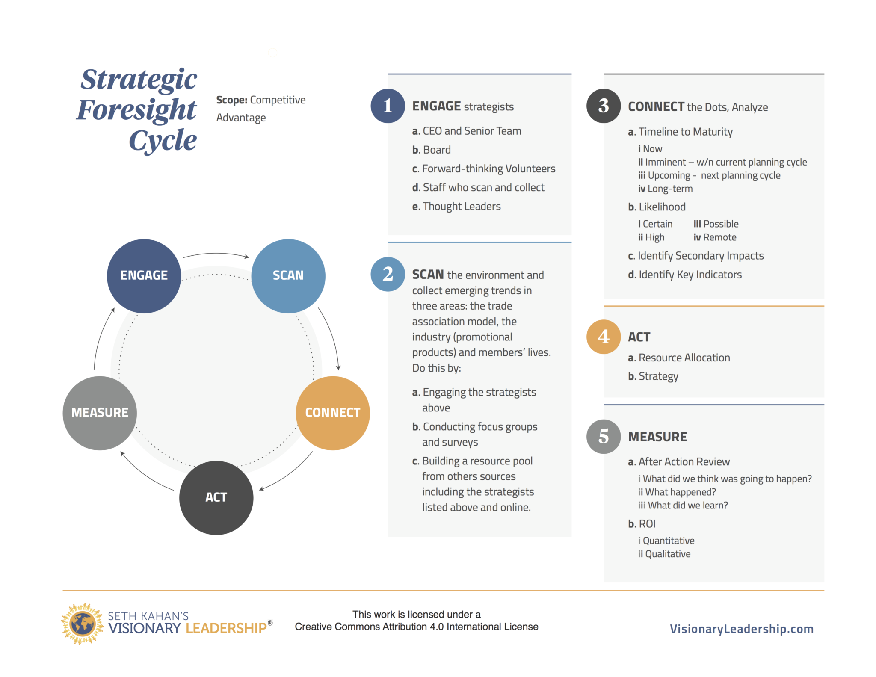
Anticipating Change through Strategic Foresight
Strategic foresight enables organizations to anticipate and prepare for disruptive changes in the business environment.
By scanning the horizon for emerging trends and weak signals, organizations can develop proactive strategies to capitalize on opportunities.
Incorporating strategic foresight into decision-making processes empowers organizations to stay ahead of the curve and drive innovation.
9
Notes:
Image source: https://visionaryleadership.com/strategic-foresight-in-5-steps/

Slide 11
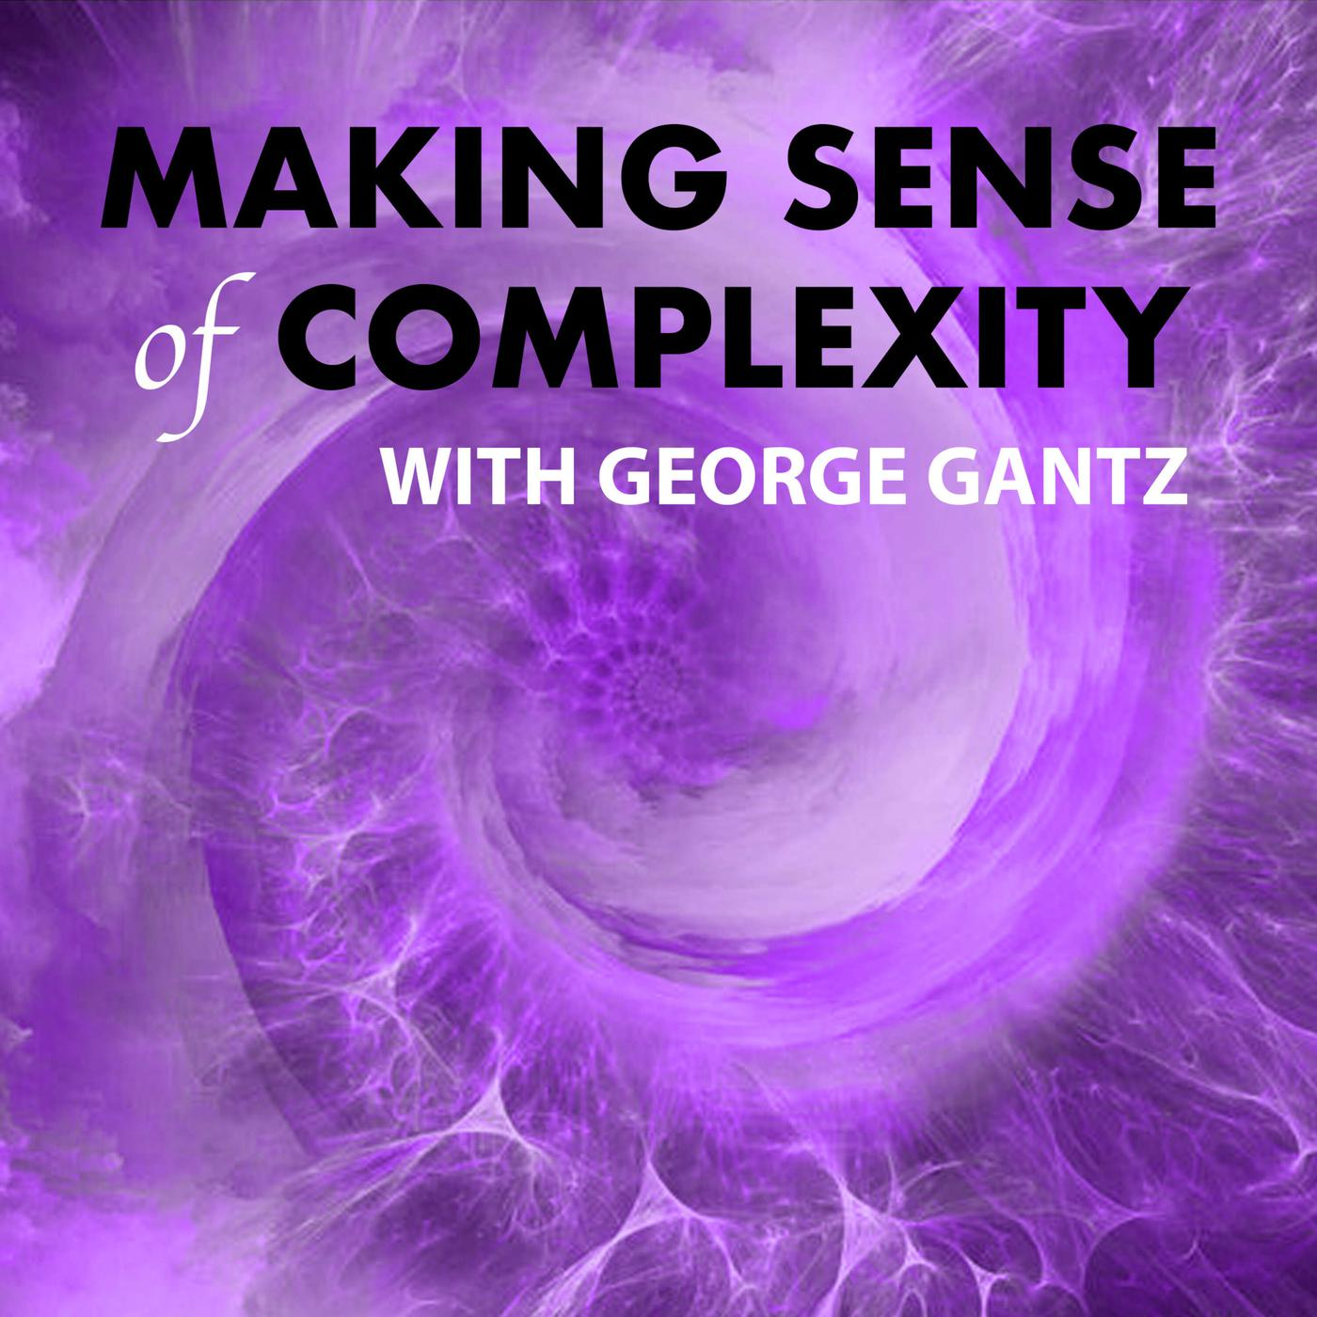
Making Sense of Complexity
In a volatile and uncertain world, sense-making is essential for understanding complex challenges and opportunities.
Sense-making helps individuals and organizations navigate ambiguity, make informed decisions, and adapt to changing circumstances.
By cultivating a sense-making mindset, organizations can foster a culture of continuous learning, adaptability, and resilience.
10
Notes:
Image source: https://www.listennotes.com/podcasts/making-sense-of-complexity-with-george-tI3eJgCPFj-/

Slide 12
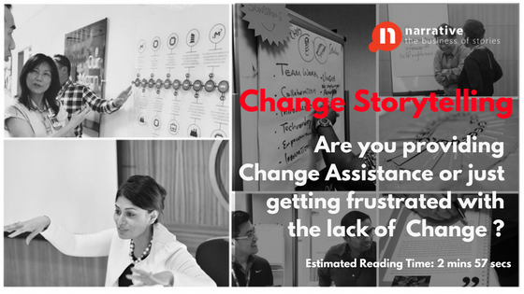
The Power of Narrative in Change Management
Storytelling can be a catalyst for change by inspiring a shared vision, engaging stakeholders, and overcoming resistance.
Crafting a narrative that communicates the why, what, and how of change can create a sense of purpose and direction.
By leveraging storytelling in change management initiatives, organizations can build trust, drive employee engagement, and facilitate successful transitions.
11
Notes:
Image source: https://narrative.com.sg/storytelling/blog/change-management-storytelling-is-change-assistance-a-part-of-your-change-story/

Slide 13
Strategic Foresight for Resilient Growth
Strategic foresight is a strategic tool for anticipating disruptions, identifying emerging opportunities, and shaping future strategies.
By integrating strategic foresight into strategic planning processes, organizations can build resilience, agility, and competitive advantage.
Proactive organizations that embrace strategic foresight are better equipped to navigate uncertainties, seize opportunities, and drive sustainable growth.
12
Notes:
Image source: https://visionaryleadership.com/strategic-foresight-in-5-steps/

Slide 14
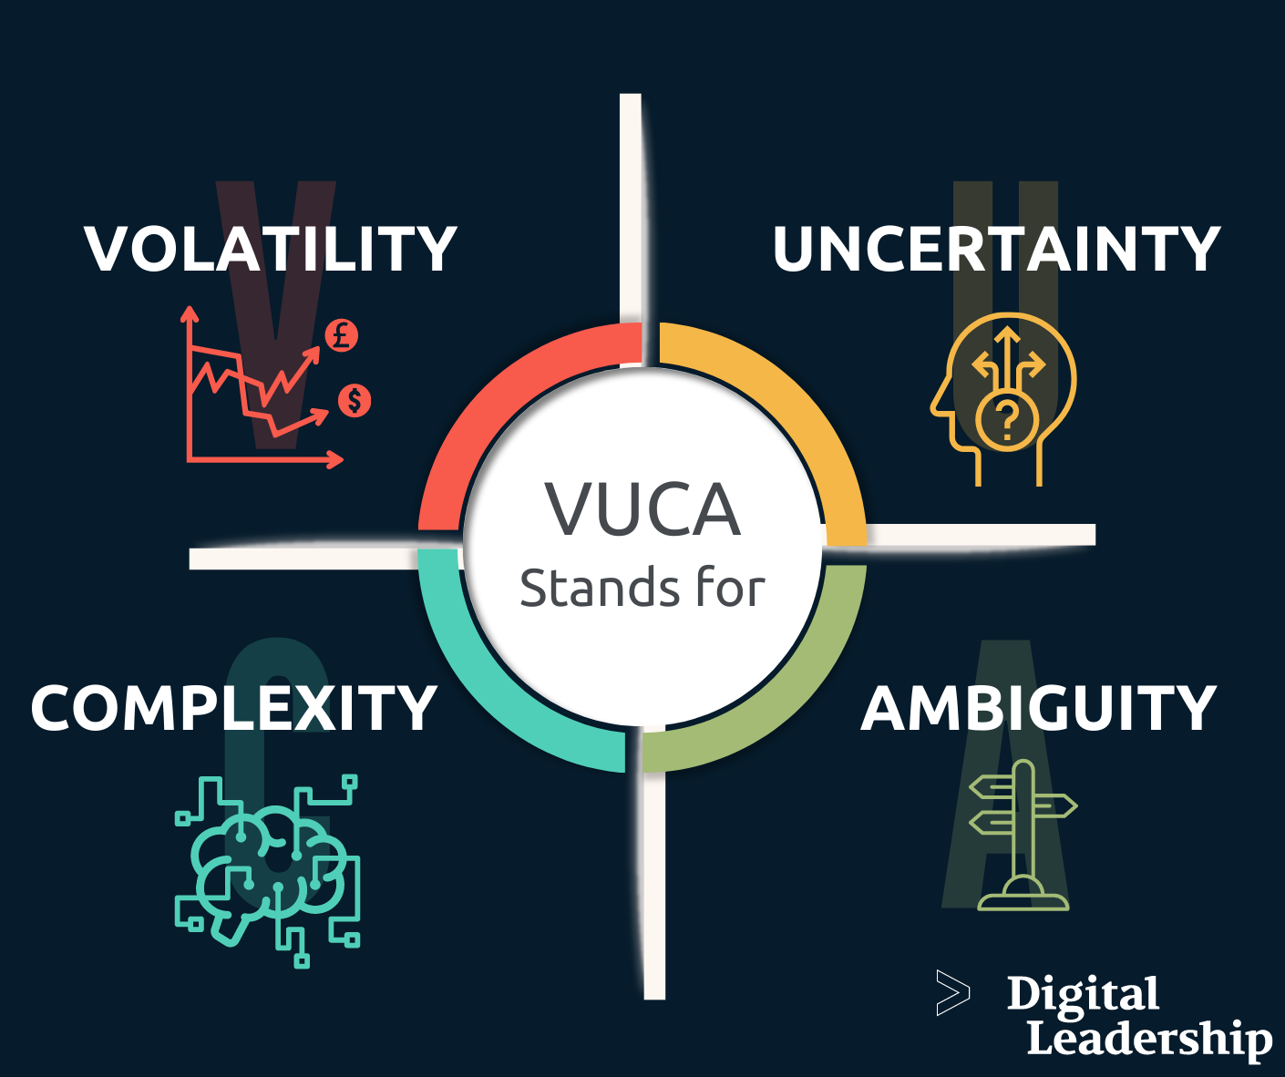
Sense-Making in a VUCA World
Sense-making is essential for navigating the volatility, uncertainty, complexity, and ambiguity (VUCA) of the modern business landscape.
By making sense of diverse and conflicting information, organizations can uncover patterns, insights, and opportunities.
Cultivating a culture of sense-making empowers individuals and organizations to adapt, innovate, and thrive in turbulent environments.
13
Notes:
Image source: https://digitalleadership.com/blog/vuca-world/

Slide 15
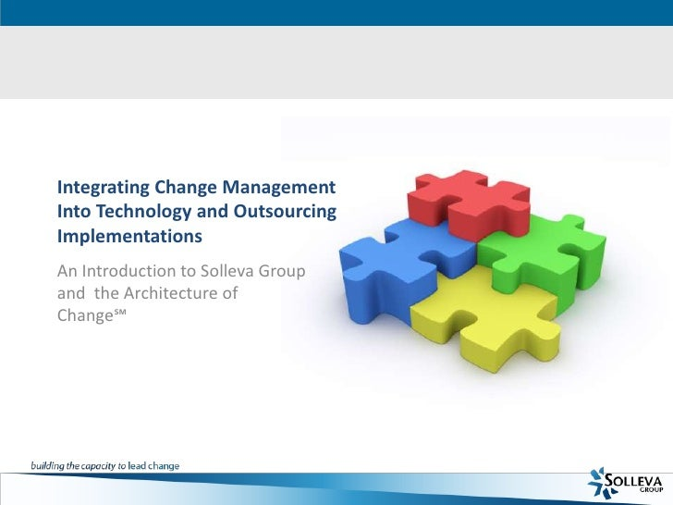
Integrating Change, Growth, and Sense-Making
Change, growth, and sense-making are interconnected processes that drive organizational evolution and transformation.
By embracing change as a catalyst for growth and leveraging sense-making to navigate complexity, organizations can create sustainable value.
Integrating these elements into organizational DNA fosters a culture of continuous learning, adaptation, and innovation.
14
Notes:
Image source: http://www.slideshare.net/evanslyke/integrating-change-management-into-technology-and-outsourcing-implementations

Slide 16
Unlocking Potential through Strategic Foresight
Strategic foresight unlocks organizational potential by expanding horizons, exploring possibilities, and challenging assumptions.
By envisioning alternative futures and developing strategic responses, organizations can proactively shape their destinies.
Embracing strategic foresight as a core competency empowers organizations to anticipate change, seize opportunities, and drive transformative growth.
15
Notes:
Image source: https://visionaryleadership.com/strategic-foresight-in-5-steps/

Slide 17
Harnessing the Power of Storytelling for Strategic Impact
Storytelling is a potent tool for creating emotional connections, shaping perceptions, and driving strategic impact.
By crafting narratives that capture the essence of organizational purpose and values, leaders can inspire action and alignment.
Leveraging storytelling as a strategic asset enables organizations to engage stakeholders, build trust, and communicate complex ideas with clarity.
16
Notes:
Image source: http://keywordsuggest.org/gallery/597124.html

Slide 18
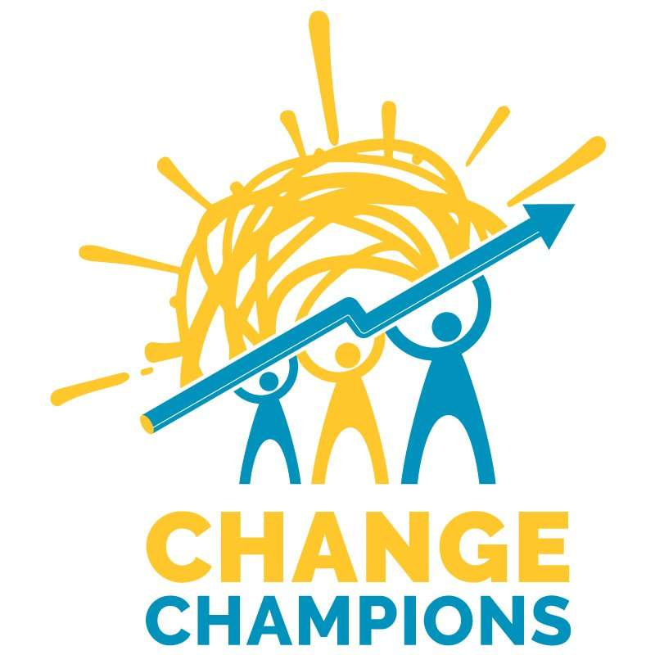
Nurturing Change Champions through Sense-Making
Sense-making nurtures change champions by fostering curiosity, critical thinking, and adaptability.
Individuals who excel at sense-making are adept at connecting dots, synthesizing information, and making informed decisions.
Cultivating a sense-making mindset within organizations empowers employees to embrace change, drive innovation, and lead transformational initiatives.
17
Notes:
Image source: https://familysunshine.org/get-involved/get-engaged/change-champions/

Slide 19
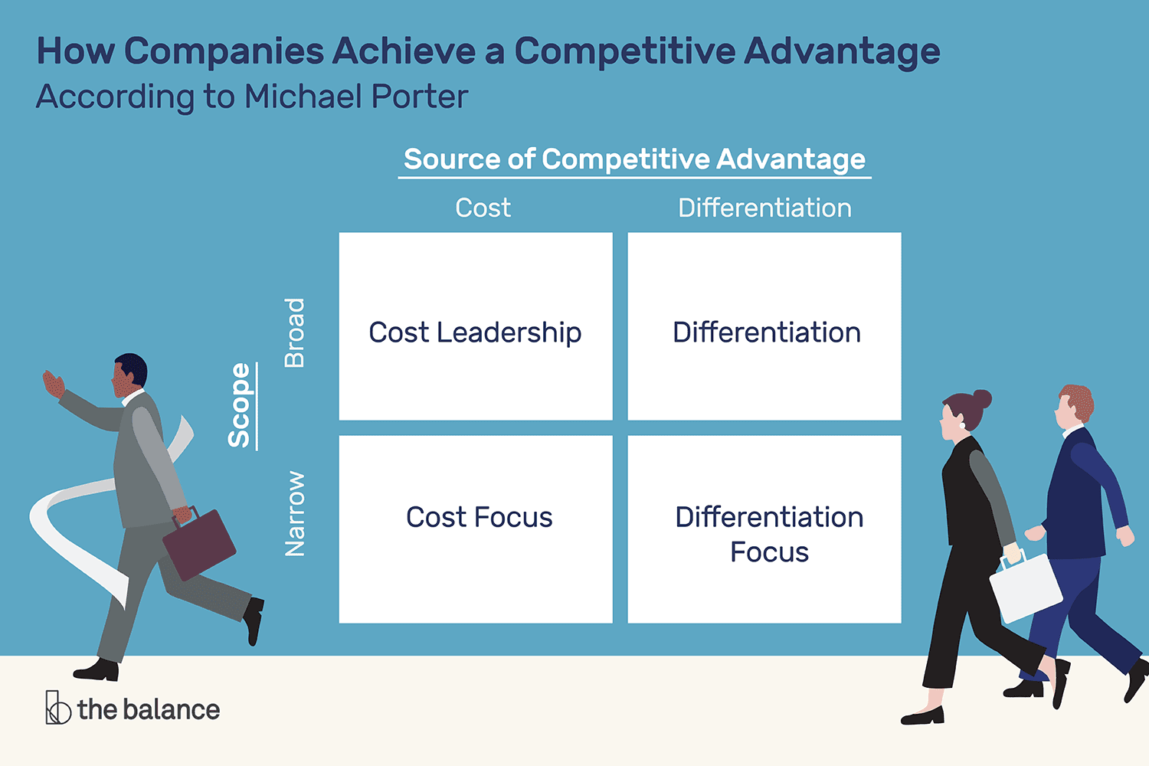
Strategic Foresight as a Competitive Advantage
Strategic foresight is a source of competitive advantage for organizations that anticipate trends, disrupt markets, and shape the future.
By developing a strategic foresight capability, organizations can stay ahead of the curve, innovate boldly, and create sustainable value.
Viewing strategic foresight as a strategic imperative enables organizations to future-proof their strategies, outmaneuver competitors, and drive enduring growth.
18
Notes:
Image source: https://www.careercliff.com/competitive-advantage-examples/

Slide 20
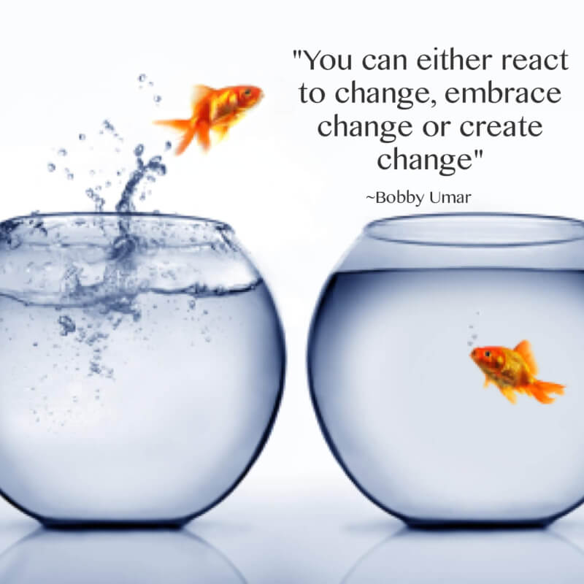
Embracing Change as a Catalyst for Growth
Change is a constant in today's dynamic business environment and is an opportunity for growth, innovation, and evolution.
Organizations that embrace change as a catalyst for growth can adapt quickly, seize opportunities, and stay ahead of the competition.
By fostering a culture of change readiness, organizations can cultivate resilience, agility, and a spirit of continuous improvement.
19
Notes:
Image source: https://quotlr.com/quotes-about-creating-change

Slide 21

Conclusion
Growth, storytelling, strategic foresight, change, and sense-making are essential elements for driving sustainable success in today's complex world.
Organizations that integrate these concepts into their strategic thinking and organizational culture can navigate uncertainties, seize opportunities, and thrive in turbulent environments.
By embracing the interplay of growth, storytelling, strategic foresight, change, and sense-making, organizations can build a foundation for enduring success.
20
Notes:
Image source: https://www.slidemake.com

